Slide 1

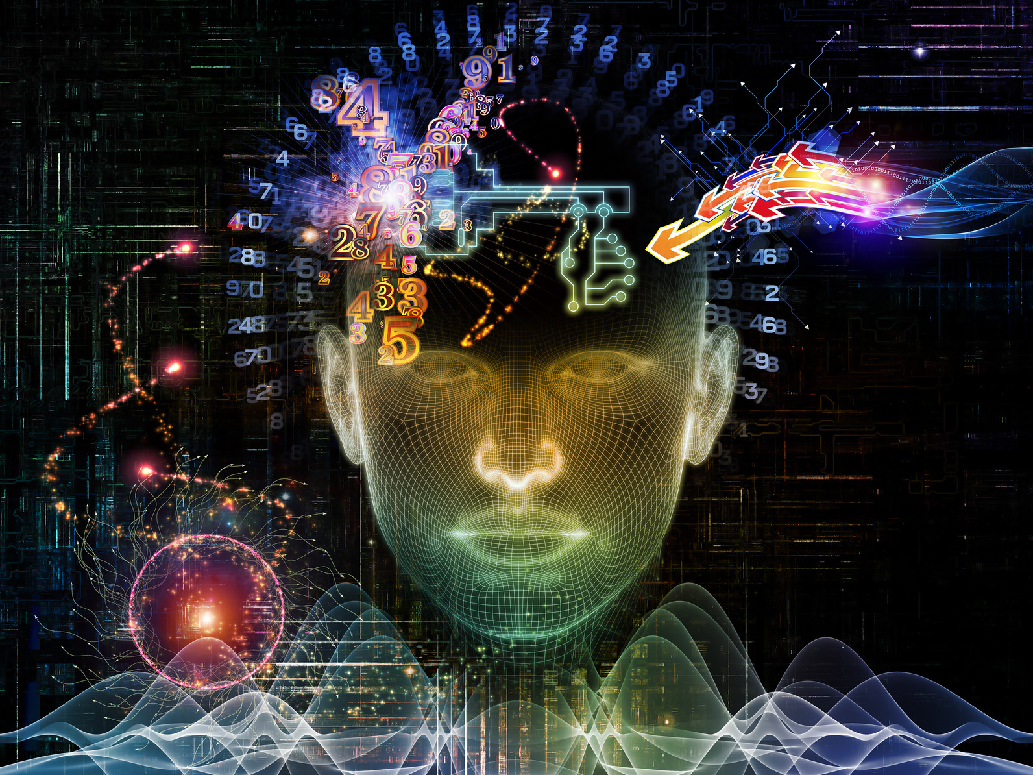

Artifial Intelligence & Machine Learning
AI
Laptop price predictor

Slide 2
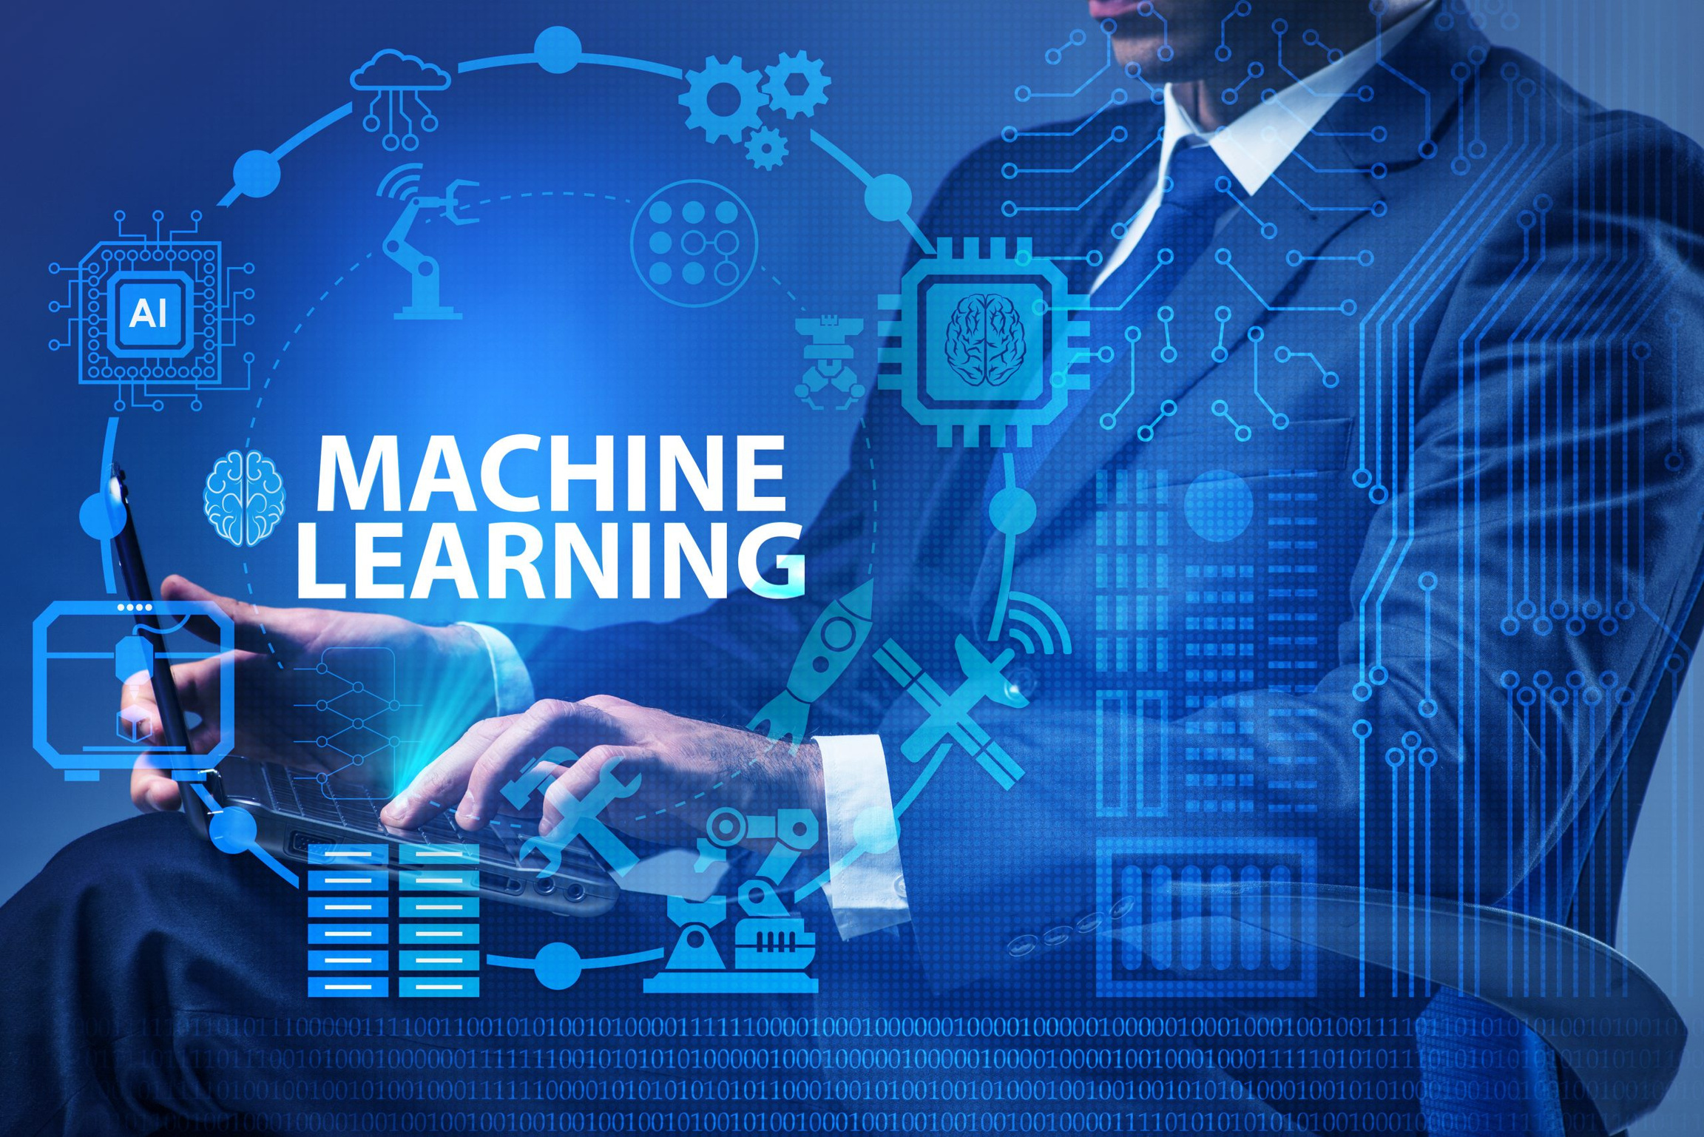

PROBLEM STATEMENT
Objective: Predict laptop prices based on features like RAM, weight, CPU type, etc.
Importance: Helps consumers and sellers make informed decisions about laptop pricing.

Slide 3
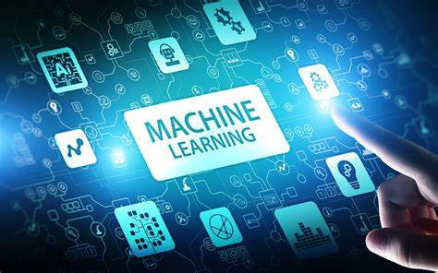
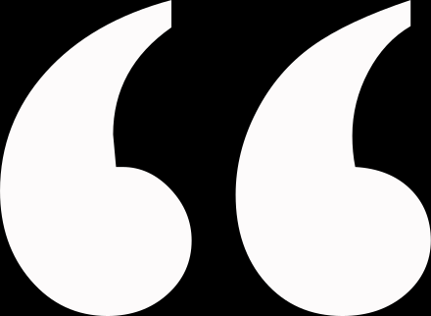
Project Overview
Key Tasks:
Data collection and preprocessing
Model training using Random Forest Regressor
Web application development using Flask
Technologies Used:
Python, Flask, scikit-learn
HTML, CSS for the frontend
Random Forest Model for predictions

Slide 4
Data Collection & Preprocessing
Dataset: Laptop specifications (e.g., RAM, weight, company, CPU type, GPU type, etc.)
Preprocessing Steps:
Handle missing values
One-hot encode categorical features (e.g., company, CPU type)
Scale numerical features
Train-test Split: Used 80% of the data for training and 20% for testing.

Slide 5
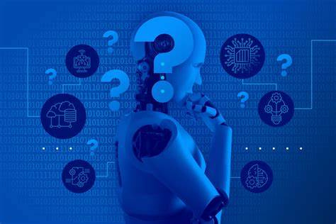
Model Development
Model: Random Forest Regressor
Why Random Forest?
Handles large datasets well
Provides good performance with minimal tuning
Model Evaluation: MAE (Mean Absolute Error) and RMSE (Root Mean Squared Error) were used to evaluate performance.

Slide 6

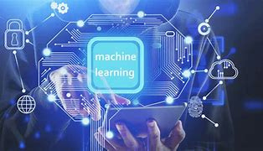

Flask Web Application
Frontend: HTML and CSS for creating the user interface
Backend: Flask to serve the machine learning model and handle user input
Key Features:
Form submission for user input (laptop specifications)
Prediction of laptop price displayed in real-time

Slide 7

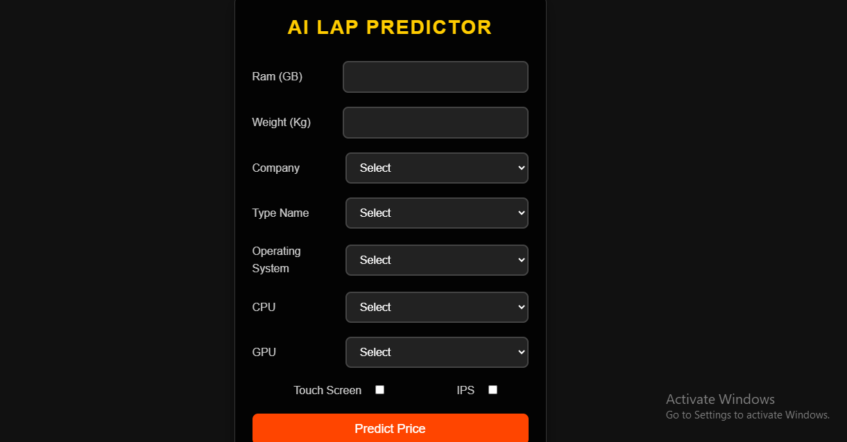
Demo

Slide 8
Model Results
Evaluation Metrics:
Mean Absolute Error (MAE)
Root Mean Squared Error (RMSE)
Performance:
The model achieved good prediction accuracy based on these metrics.

Slide 9

Challenges & Issues
Challenges Encountered:
Missing or incomplete data handling
Categorical feature encoding
Ensuring model performance with unseen data
Limitations:
May need more data to improve accuracy
Model performance can vary with different laptop specifications
Claudia Alves
Everest Cantu
Aaron Loeb

Slide 10
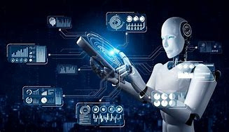
Conclusion
Key Takeaways:
Successfully developed a machine learning-based price prediction tool.
Integrated Flask to create a simple yet functional web application.
Future Work:
Use more advanced models for better accuracy
Expand the dataset with more diverse laptop specifications

Slide 11
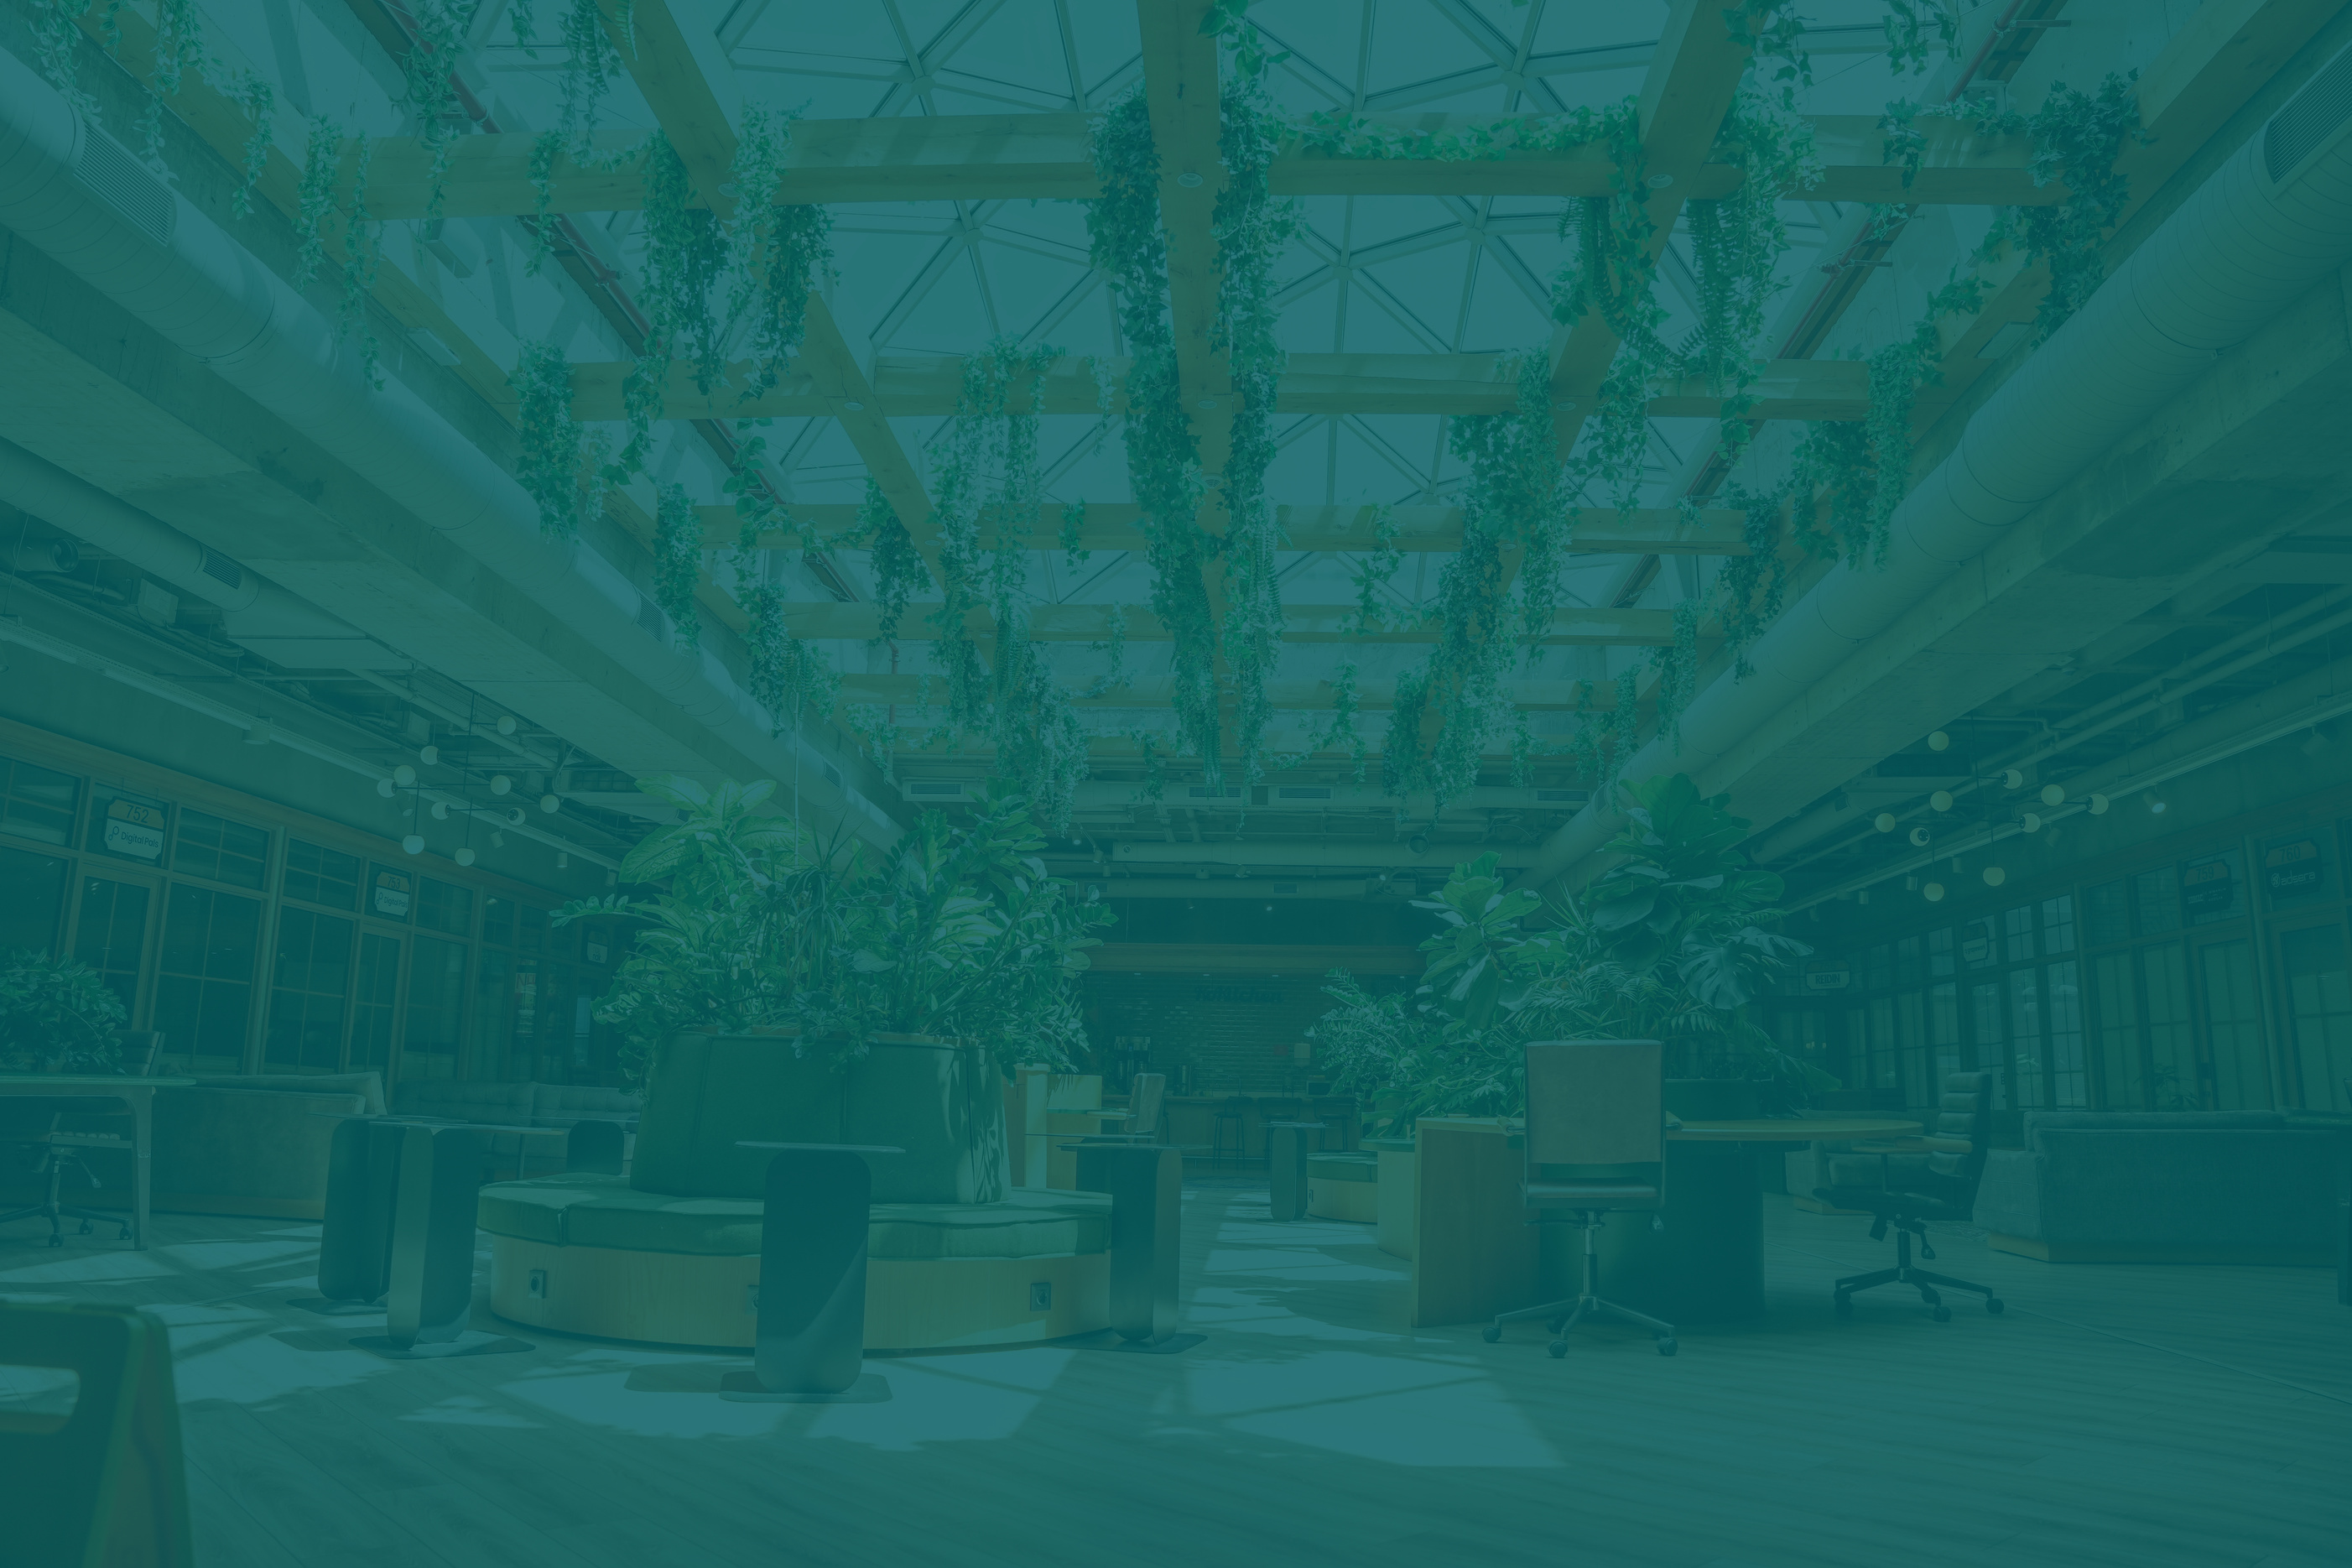
THANK YOU

